Slide 1
Portfolio Presentation
By Amber Emeny

Slide 2
Design Process

Slide 3
Website Sitemap
Index
Portfolio
Blog
Contact
Github
Twitter
Pinterest
LinkedIn

Slide 4
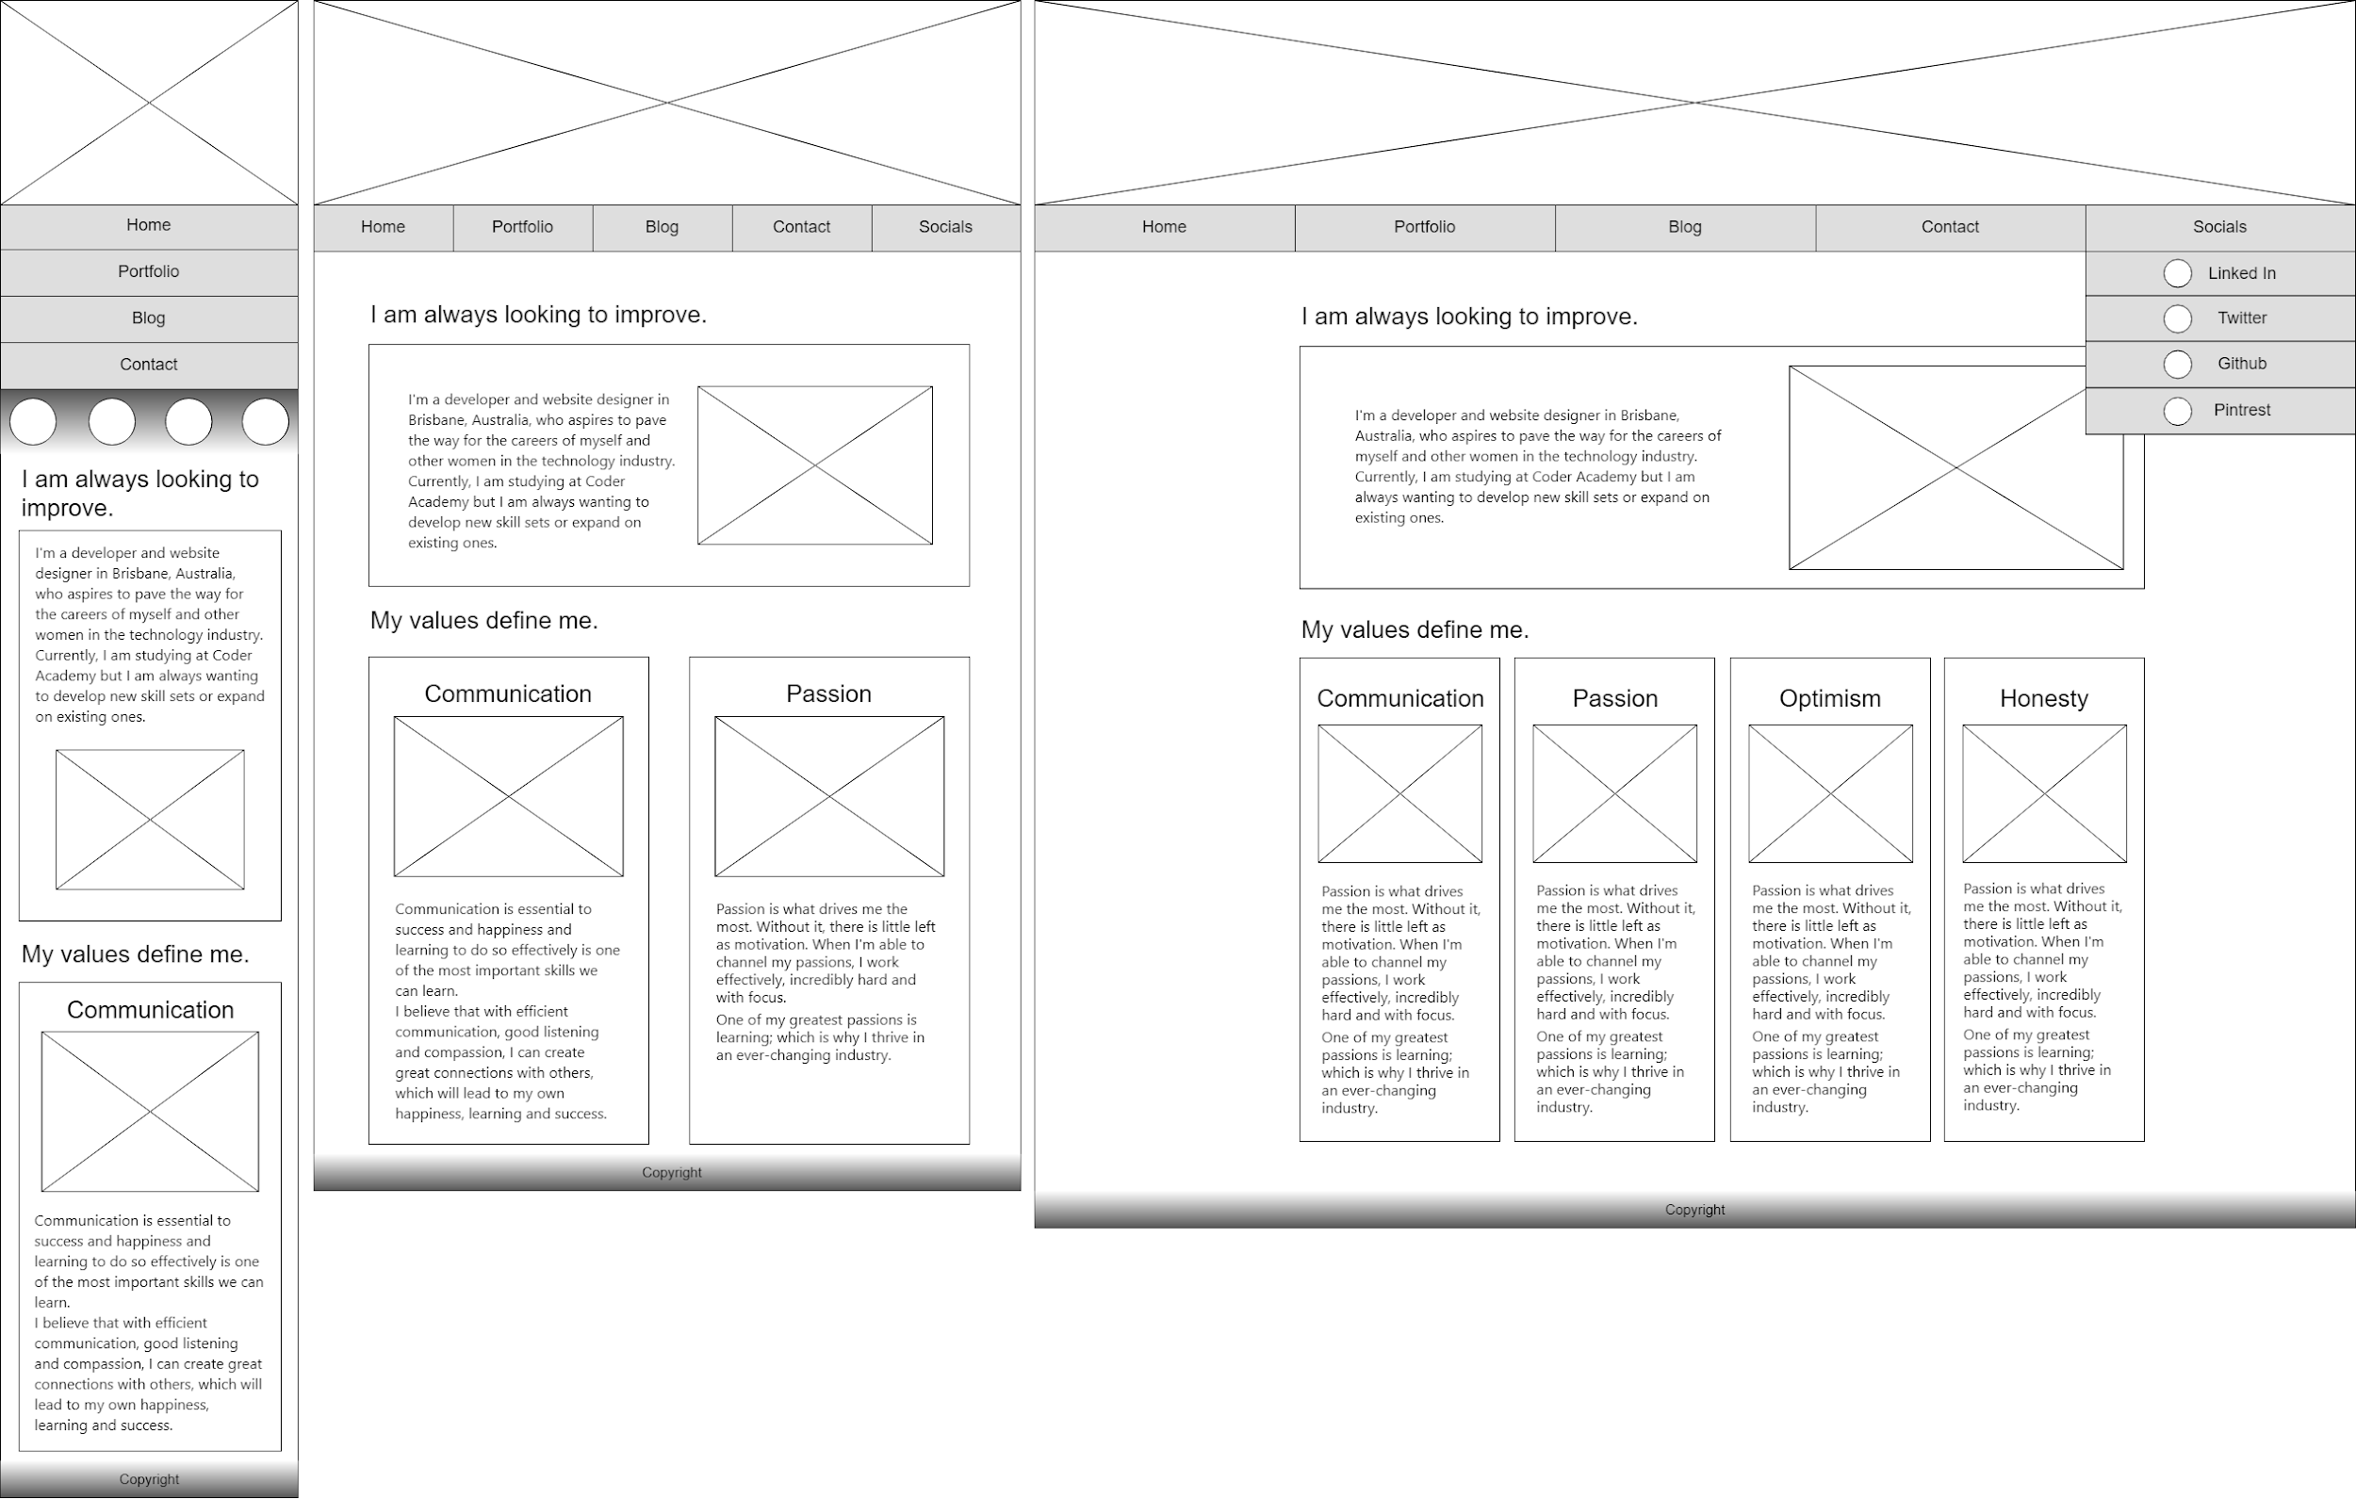
Index Wireframe

Slide 5
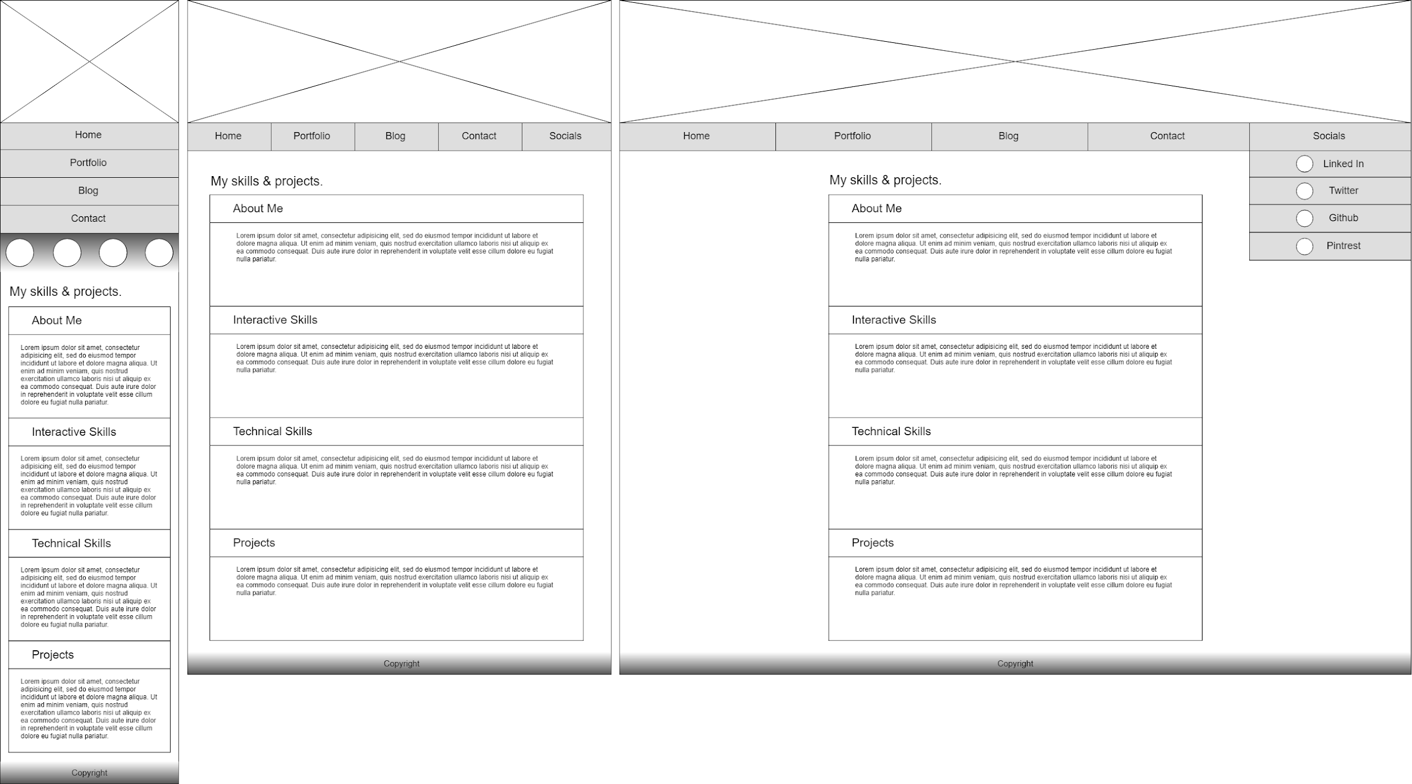
Portfolio Wireframe

Slide 6
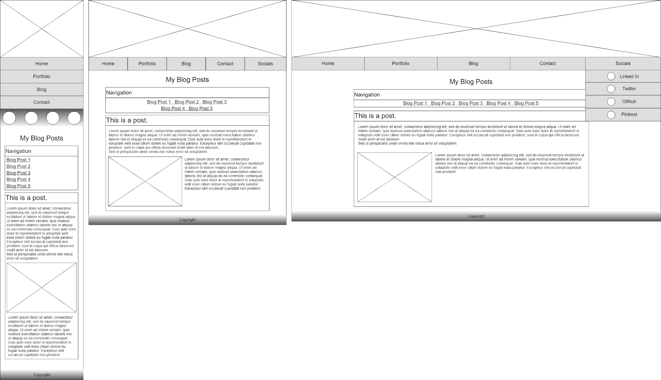
Blog Wireframe

Slide 7
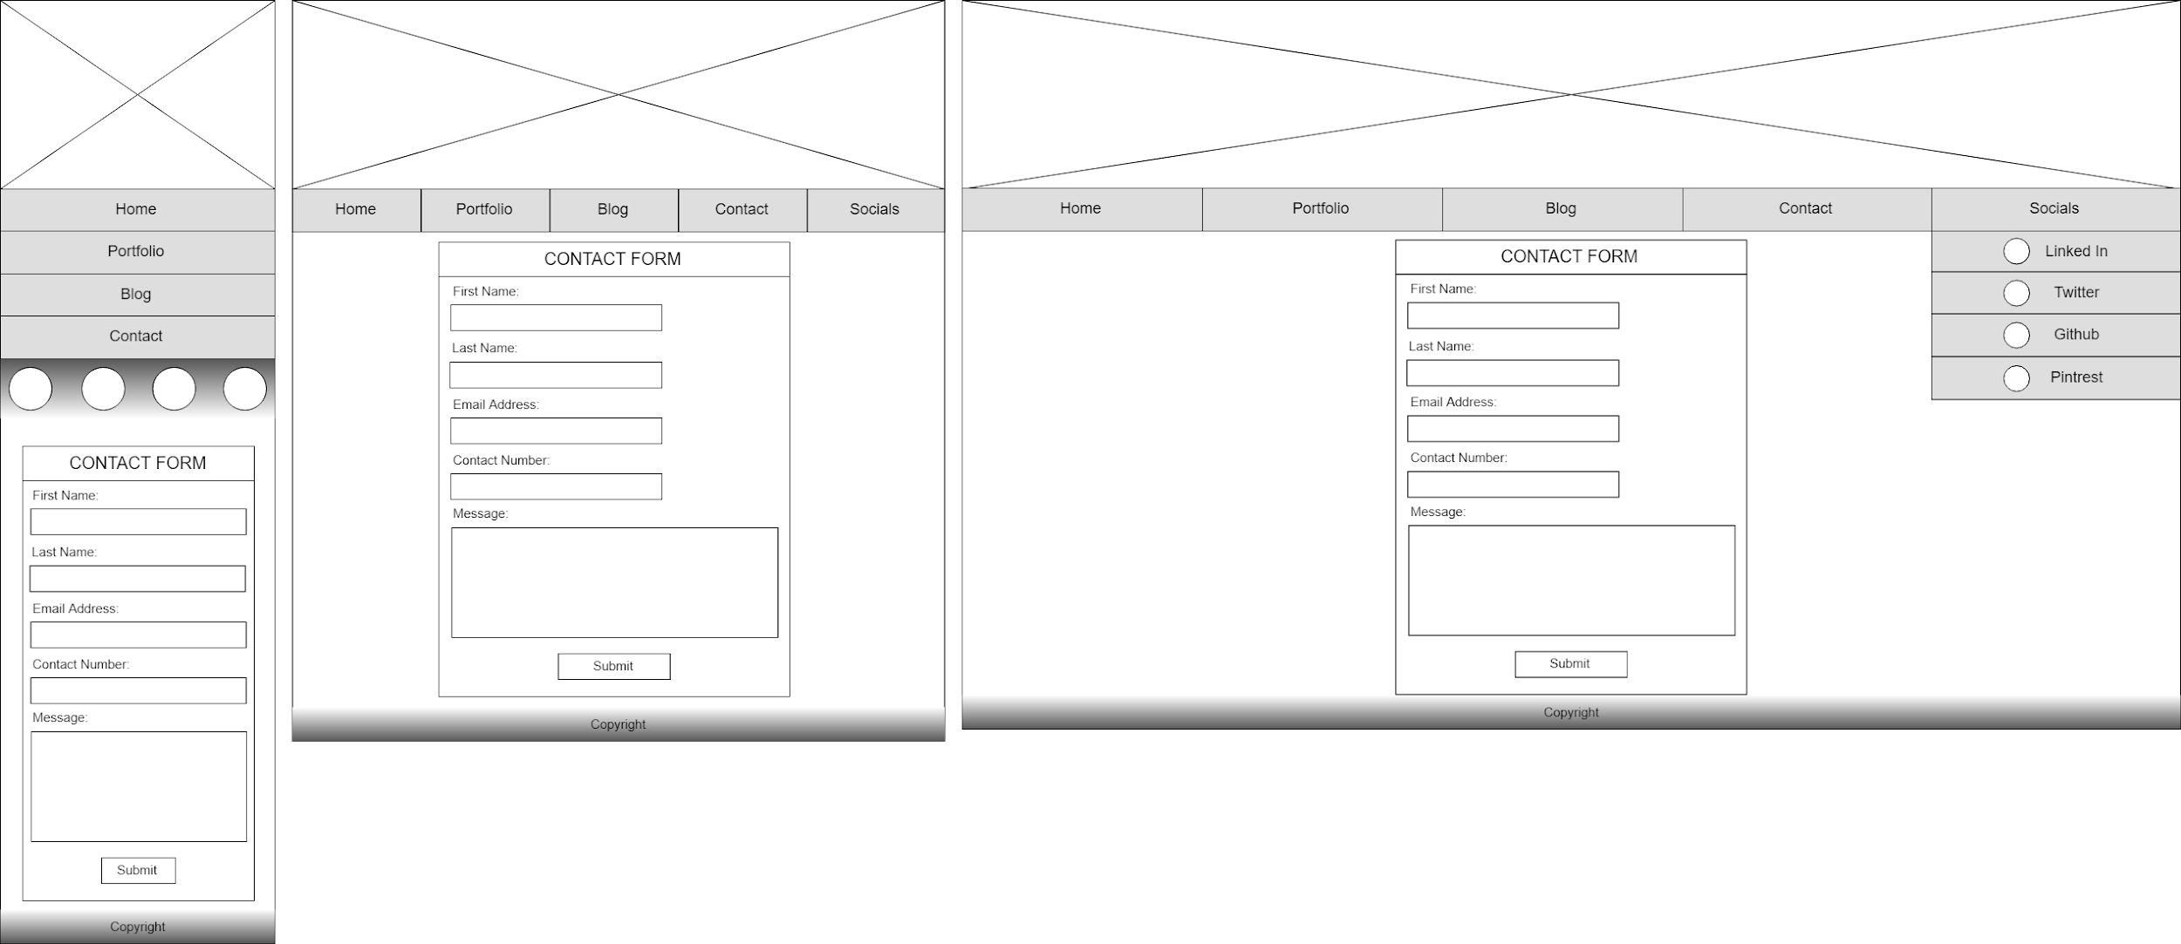
Contact Wireframe

Slide 8
Development

Slide 9
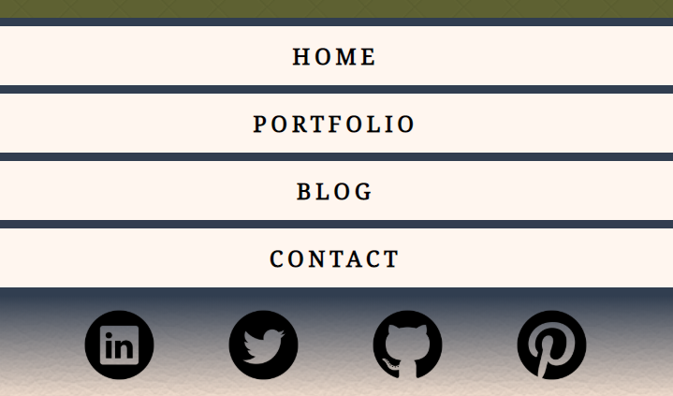
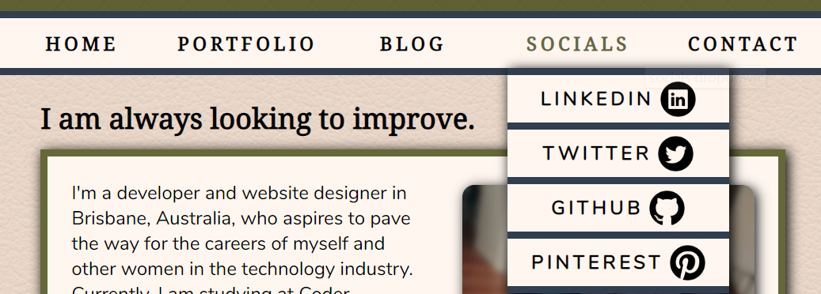
Navigation Features
Mobile navigation design.
Desktop Navigation Design.
Notes:
Navigation
Mockup Decisions
Navigation is an unordered list displayed as stacked blocks in mobile and horizontal aligned blocks in tablet and desktop.
Socials are directly under the navigation as icons on mobile and as a dropdown on tablet and desktop.
Components Used
Nav, unordered list and links - used together to create a navigation for website pages. Also uses semantically correct elements.
Unordered list and images - used to create a separate socials navigation bar for mobile. Set up for ease of use for mobile users.
Divs and unordered list and links - used together to create the dropdown menu on tablet and desktop. Provides visual ease for users with a larger screen as opposed to the mobile version.

Slide 10
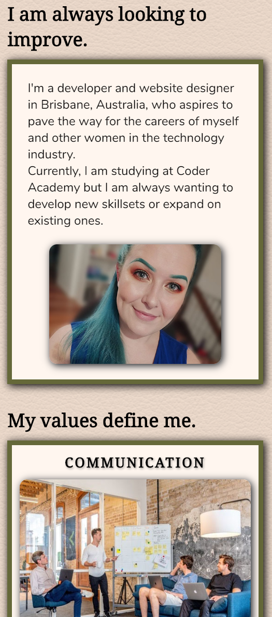
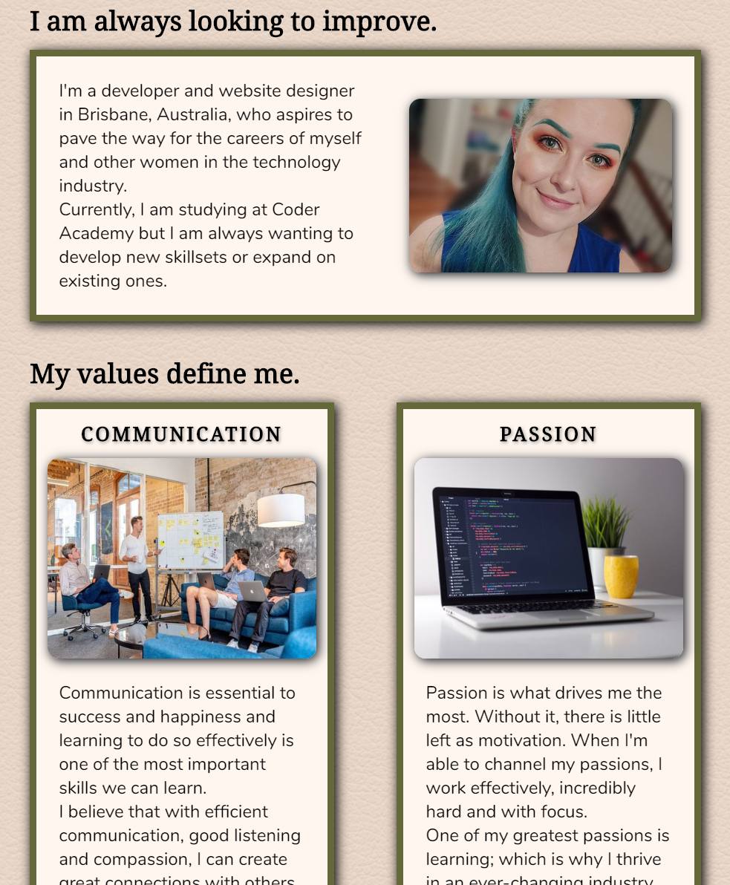
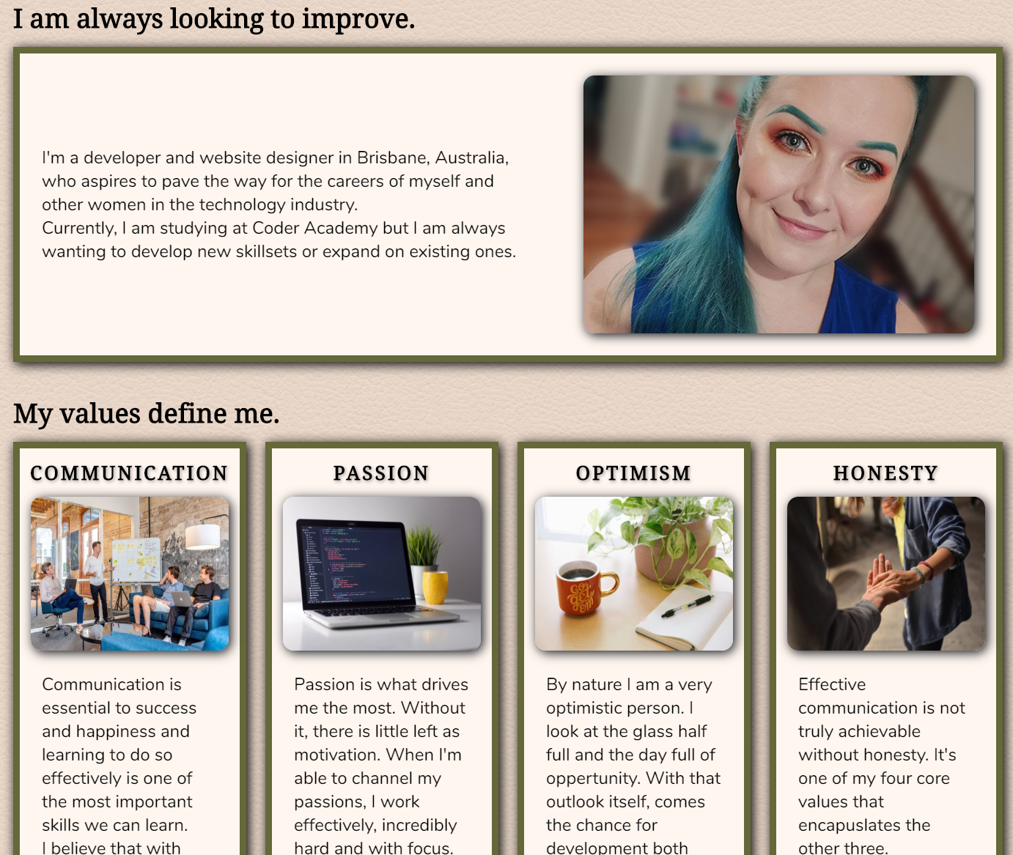
Index Features
Mobile and tablet index design.
Desktop index design.
Notes:
Index
Mockup Decisions
Separate divs display main page content and images.
Components Used - Content
Headings - used to direct the attention of the audience.
Sections - used to separate blocks of content for visual flow.
Articles - used inside the sections to house content and provide accessibility by using semantic elements.
Images - used to grab attention and utilise interesting visuals.

Slide 11
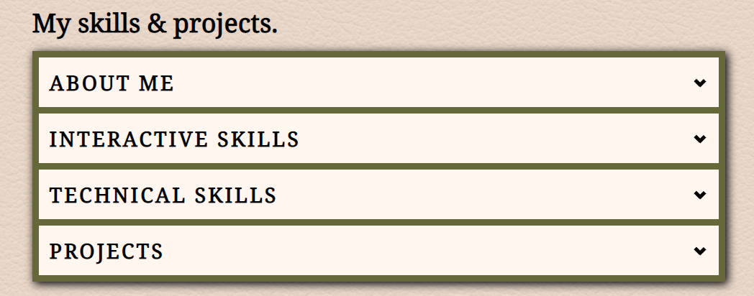
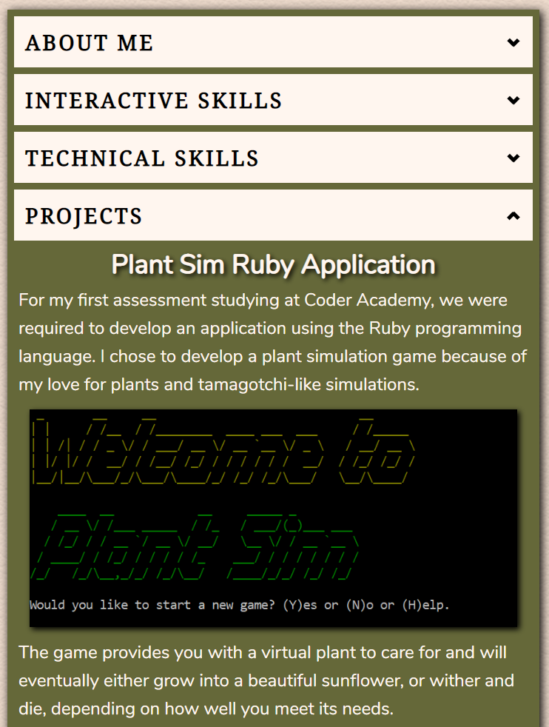
Portfolio Features
Portfolio accordion design.
Notes:
Portfolio
Mockup Decisions
Each four sections will be displayed in an accordion style div to minimise the length of the page where possible and effectively separate the content sections.
Components Used
Headings - used to direct the user to relevant content.
Divs - used to house and separate content as well as label sections to apply css styling effectively.
Span - used to uniquely style elements of the page according to the section and content.
Images - used to direct the attention of the audience.
Checkbox - doesn’t directly engage the audience but is featured in the styling and code of the accordion.

Slide 12
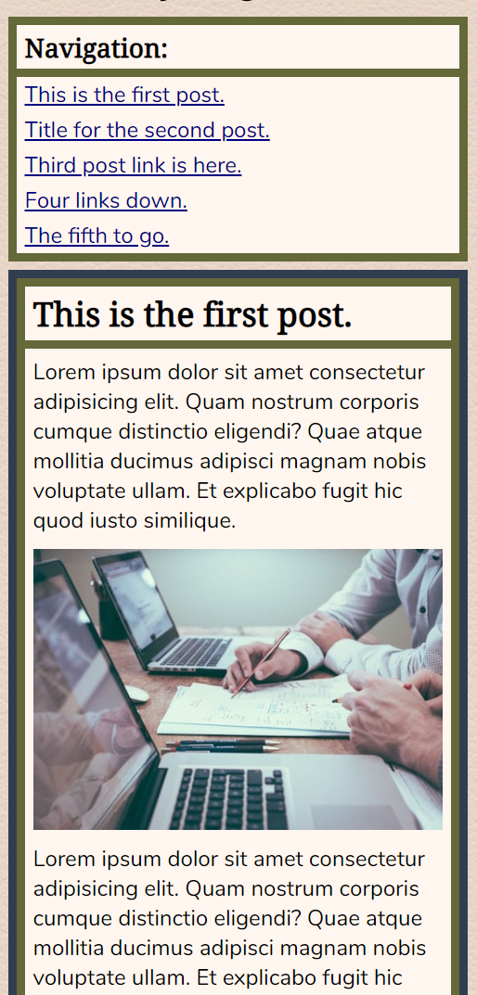
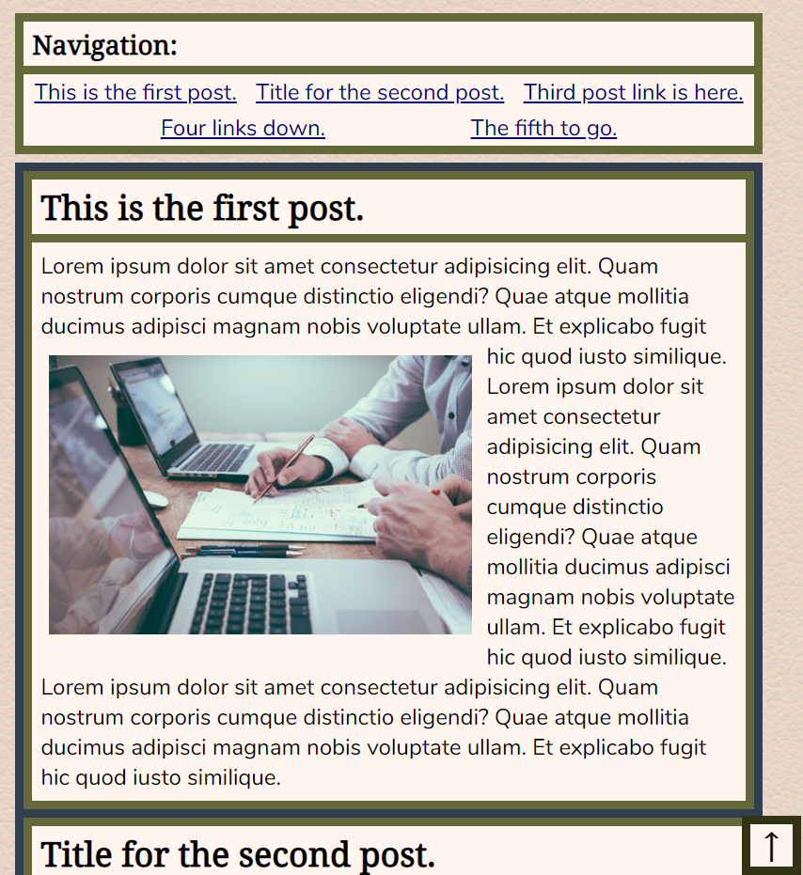
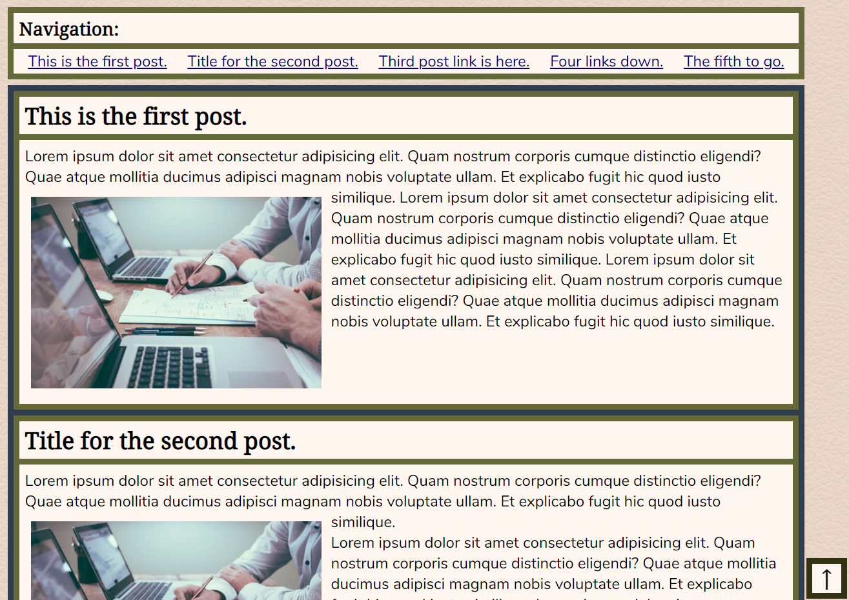
Blog Features
Desktop blog page design.
Mobile and tablet blog page design.
Notes:
Blog
Mockup Decisions
Utilises a blog navigation that jumps to related headings lower on the page. Responsive to screen size.
Each post is displayed in tandem down the page, providing a smooth experience for a mobile user.
Each post features and in-line and wrapped image for ease of reading.
Each post has a link at the bottom to send the user to the top of the navigation.
Components Used
Headings - used to direct the user's attention to the relevant content.
Navigation and unordered list - used to compile a list of links for each blog heading.
Section - semantically correct wrapper for each blog post.
Article - houses post text and images.

Slide 13
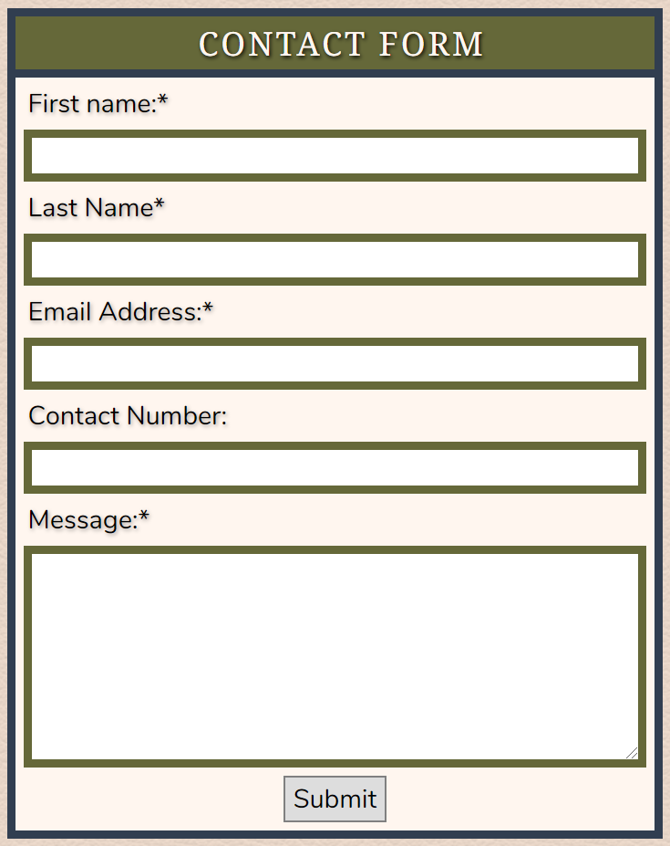
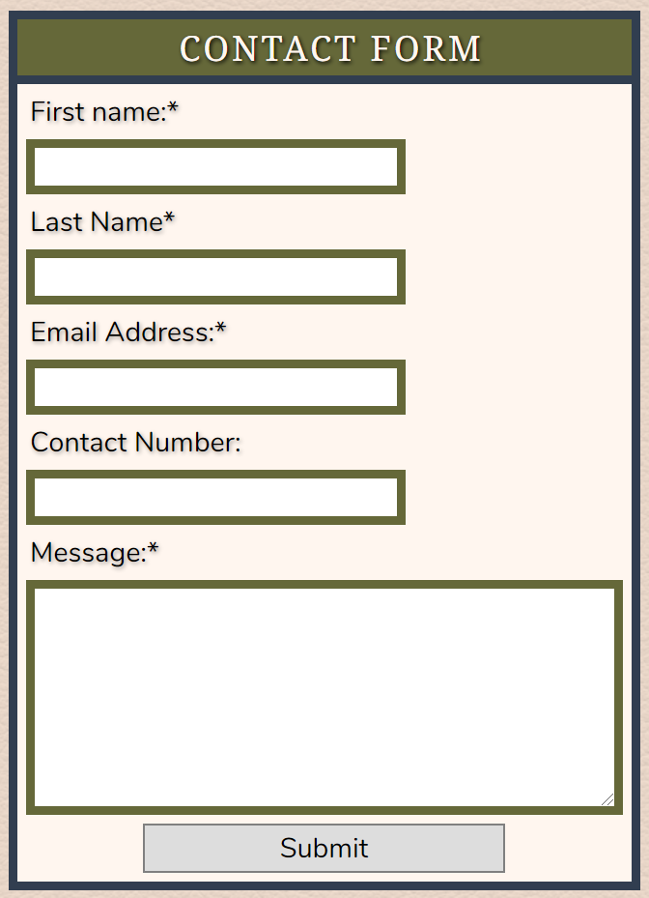
Contact Form Features
Mobile and contact form design.
Desktop and tablet contact form design.
Notes:
Contact
Mockup Decisions
Centralised container to separate content from the page borders.
Mobile text inputs take up 100% of the container to maximise use of space.
Tablet and desktop text inputs take up 60% of the container to create a more visually comfortable experience.
Content reaches a smaller maximum width to ensure ease of use for larger screens.
Components Used
Headings - used to label the content appropriately.
Text inputs and text area - used to gather data for the users message.
Submit buttons - used to activate the action to send the users message.
Divs - used to wrap and contain main content.

Slide 14
Reflection

Slide 15
Challenges
Favorite Parts
Questions?
Sanity management.
Using SCSS for the first time.
Theme decision.
Live server.
Using SCSS for the first time.
Layout design.
Learning opportunity.

